Slide 1

XLA Compiler
Just-In-Time Compilation in TensorFlow

Slide 2
1
Why does TensorFlow have XLA?
Background Introduction

Slide 3
TensorFlow
What is TensorFlow?
Input0
f32[1024]
Input1
f32[1024]
An open source software library for numerical computation using data flow graphs.
Op
Add
f32[1024]
What is data flow graphs?
Tensor
Nodes: mathematical operations
Edges: multidimensional data arrays
...

Slide 4
TensorFlow
Flexible
Expressive
Extensible

Slide 5


Flexibility
Allows researchers to richly express themselves
Operation may be data dependent in unobvious ways

Slide 6
Flexibility
Input0
f32[???]
Input1
f32[???]
Op
Add
f32[???]
Tensor
...

Slide 7
Expressive
TensorFlow has a large Operation vocabulary, why?
To keep TensorFlow expressive, more operations are needed in practice.
Composition of existing operations is not efficient.
Result in more ops, leading more kernel launches, memory allocations.

Slide 8
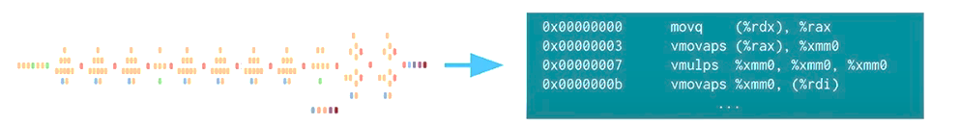
How do TensorFlow keep the strengths, but add more speed?

Slide 9
2
How does XLA work?
Compilation Strategies of XLA

Slide 10
//tensorflow/compiler/tf2xla
//tensorflow/compiler/xla
//tensorflow/compiler/jit
//tensorflow/compiler/aot
This is a story of the TensorFlow Compiler Subdirectory…

Slide 11
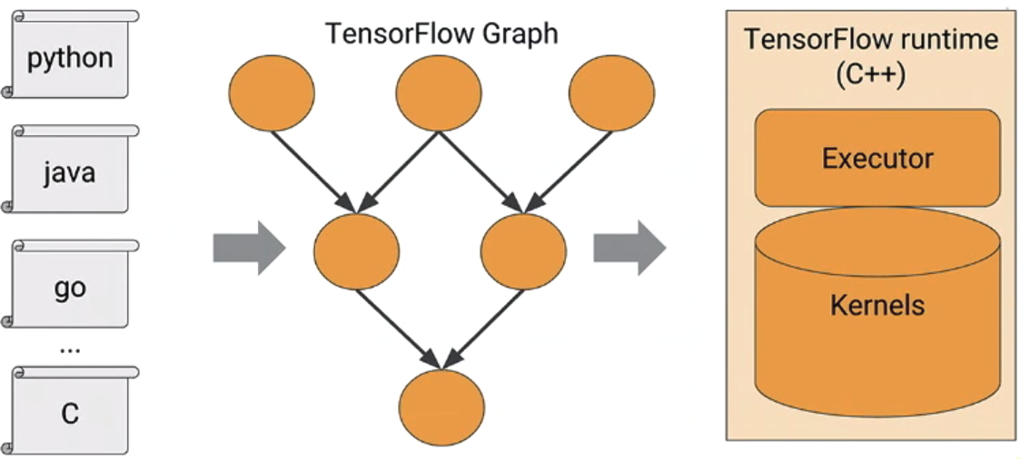
TF in one Picture
TensorFlow runtime run each node operation in Kernels.

Slide 12
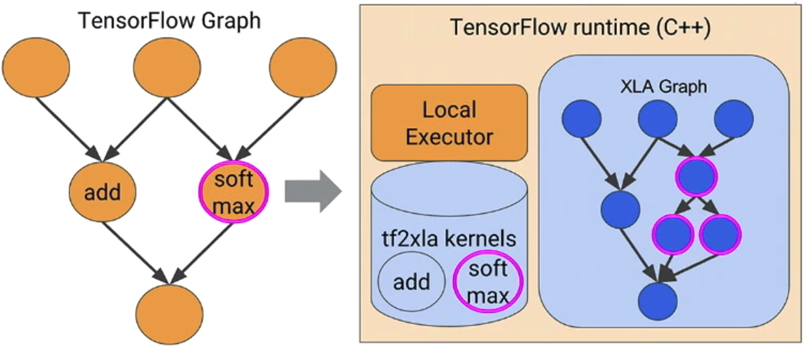
tf2xla: Graph
TensorFlow Graph will change to XLA Graph for optimization.
//tensorflow/compiler/tf2xla

Slide 13
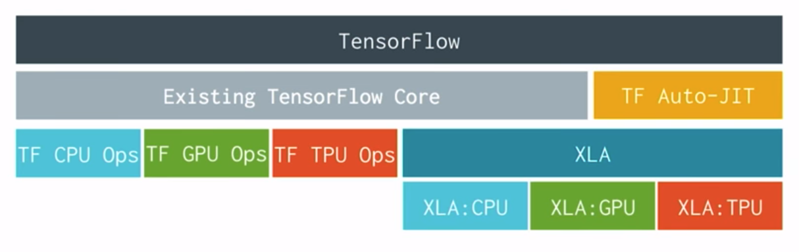
TF-Level Block Diagram
Abstraction of TensorFlow, choose ops to run on XLA or Existing Core.

Slide 14
//tensorflow/compiler/tf2xla
//tensorflow/compiler/xla
//tensorflow/compiler/jit
//tensorflow/compiler/aot
XLA to llvm and code generation…

Slide 15
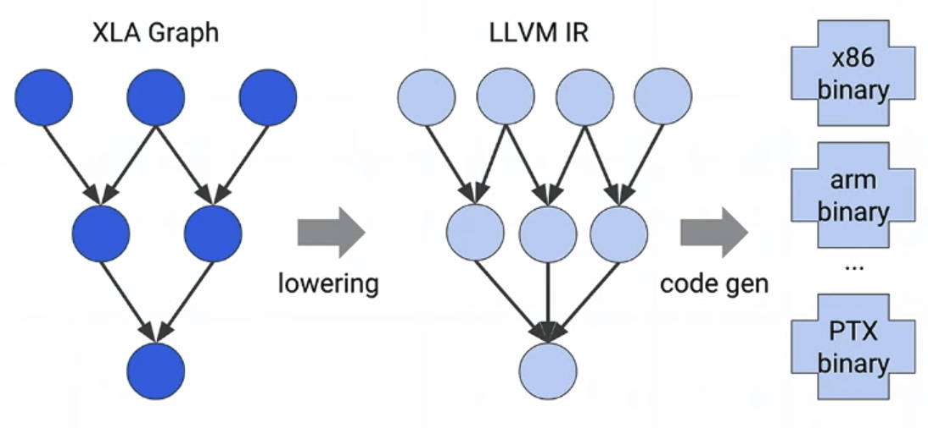
XLA in one Picture
Optimizing compiler and runtime, targeting CPU, GPU, etc.
//tensorflow/compiler/xla

Slide 16
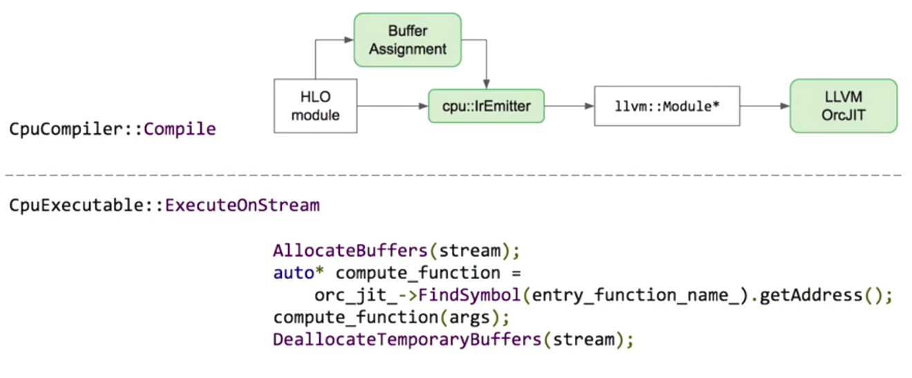
CPU CodeGen and Runtime

Slide 17
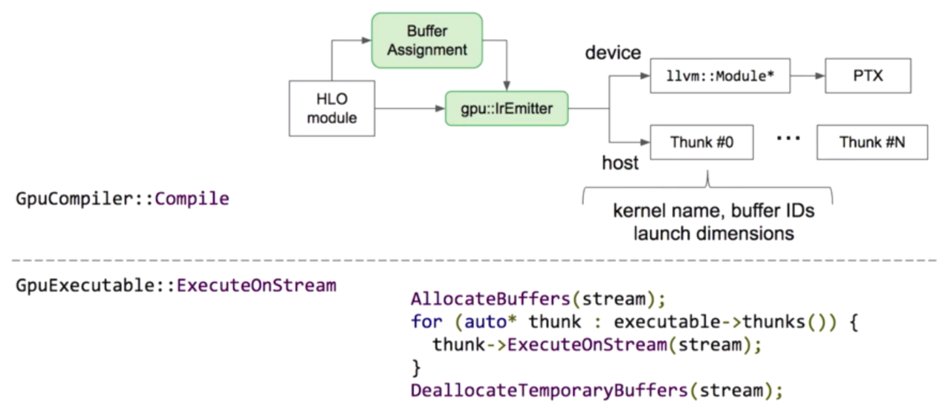
GPU CodeGen and Runtime

Slide 18
//tensorflow/compiler/tf2xla
//tensorflow/compiler/xla
//tensorflow/compiler/jit
//tensorflow/compiler/aot
Just-In-Time Compilation…

Slide 19
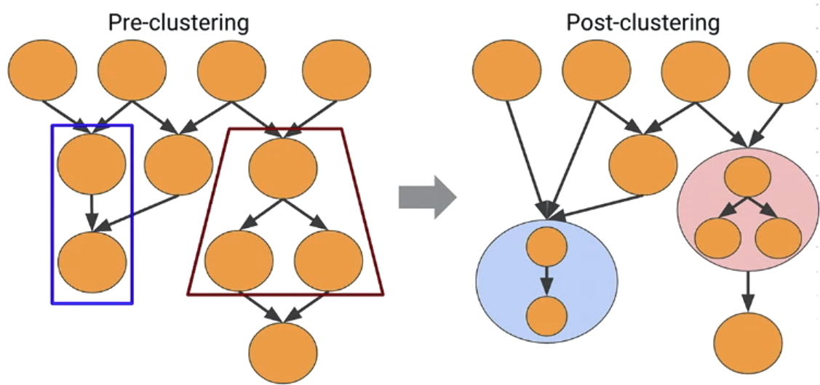
JIT: Operation Fusion
The most interesting optimization of JIT is operation fusion.
//tensorflow/compiler/jit

Slide 20
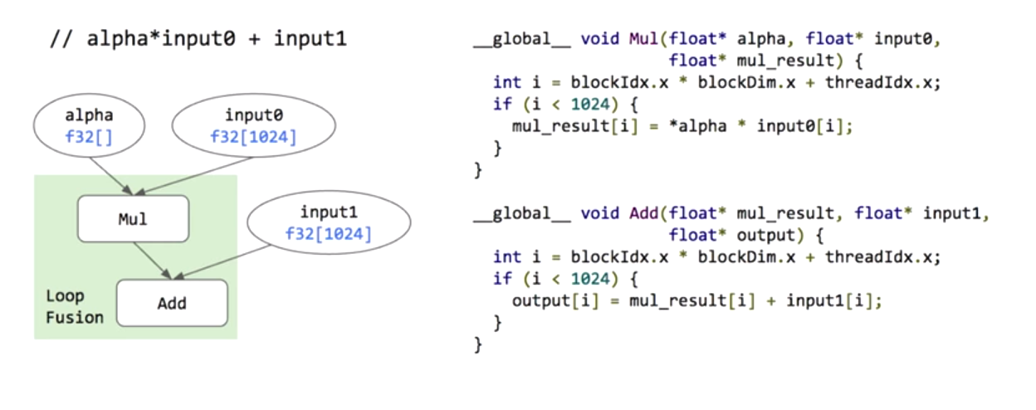
Fusing Element-wise OPs

Slide 21
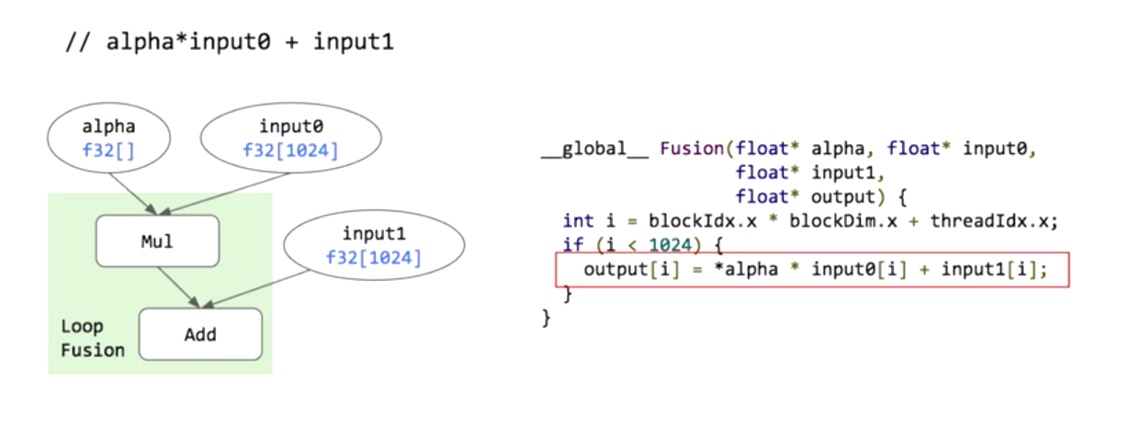
Fusing Element-wise OPs

Slide 22
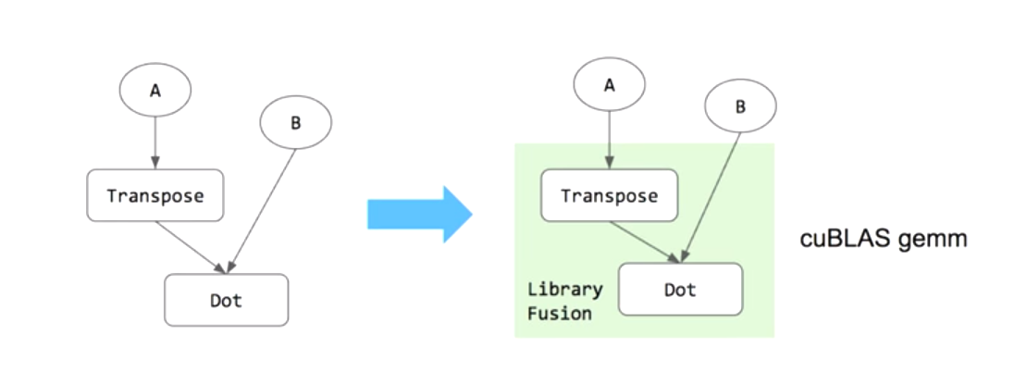
Library Fusions

Slide 23
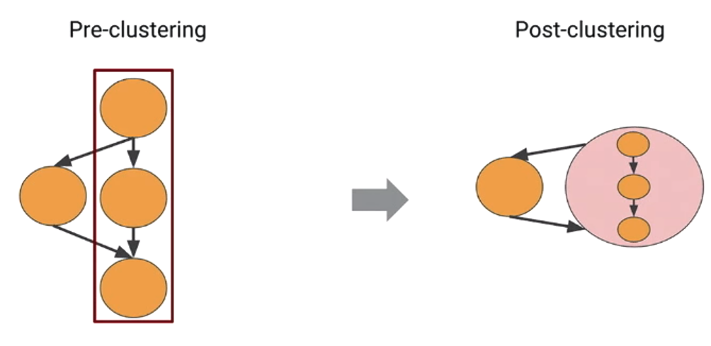
JIT: Operation Fusion
Compiler have to avoid some wrong fusion which will lead to deadlocks.

Slide 24
//tensorflow/compiler/tf2xla
//tensorflow/compiler/xla
//tensorflow/compiler/jit
//tensorflow/compiler/aot
Ahead-of-time Compilation…

Slide 25
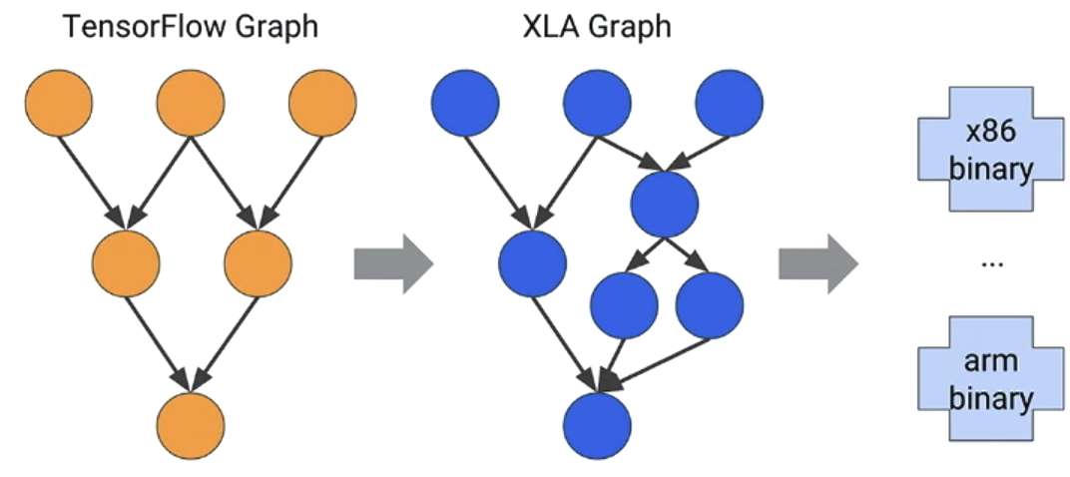
Ahead-of-time compilation
AOT compilation transfer all TensorFlow Graph nodes to XLA Graph nodes.

Slide 26
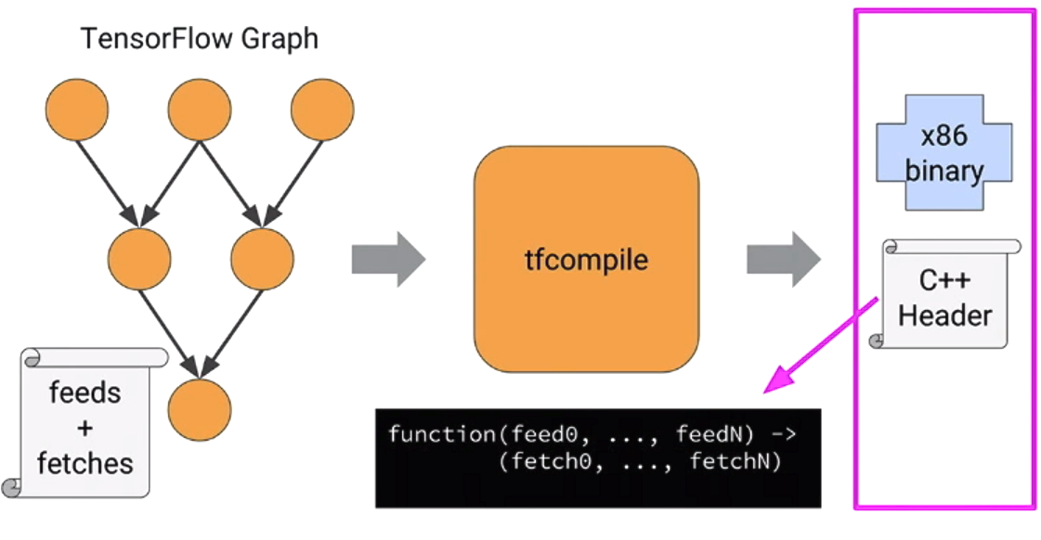
tfcompile: Graph compiler
AOT compilation transfer all TensorFlow Graph nodes to XLA Graph nodes.

Slide 27
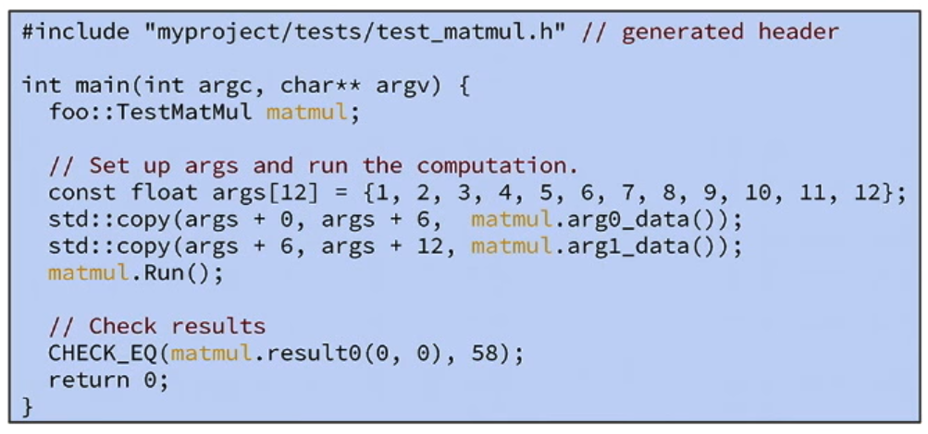
tfcompile: Graph compiler
The C++ header can be used pretty simple.
Write code to call the computation:

Slide 28
3
How does XLA perform?
Performance benchmarks of XLA

Slide 29
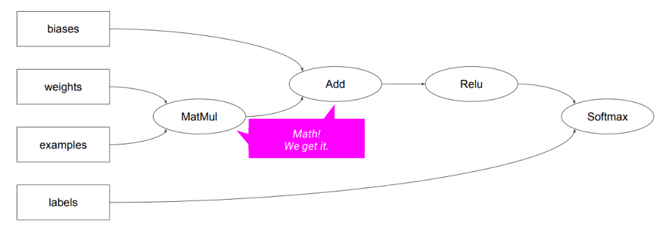
MNIST Example

Slide 30
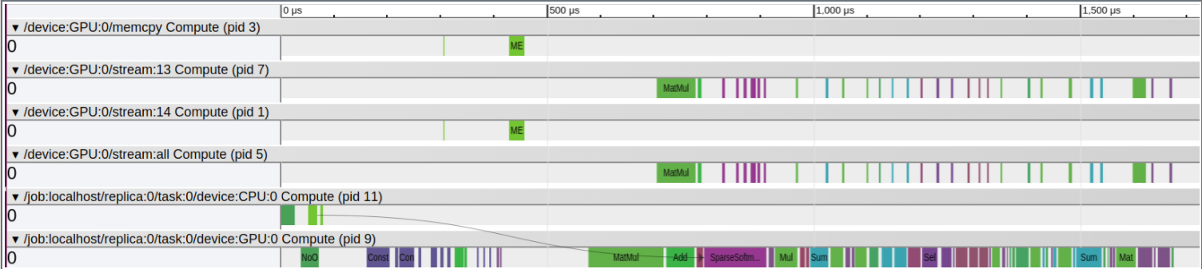
Profiling
Profiling with CUDA Profiling Tools Interface.

Slide 31
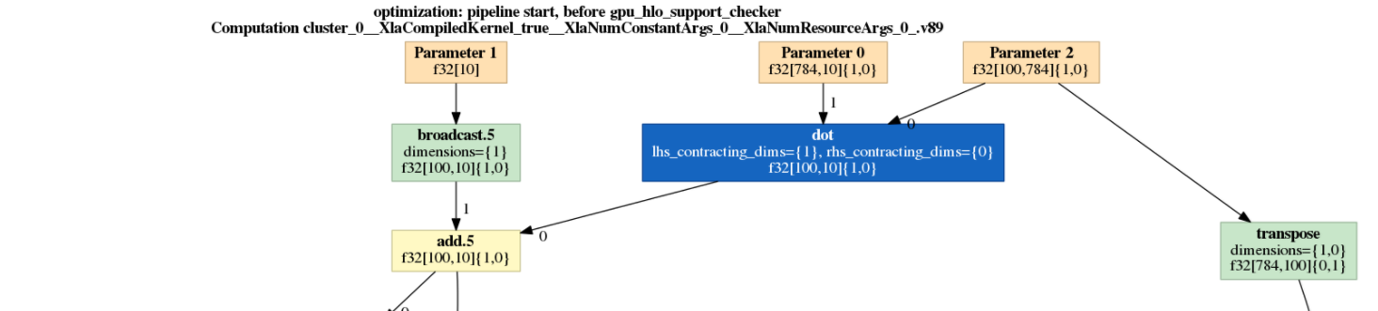
Data Flow Optimization
The data graph before XLA and the data graph after XLA:

Slide 32
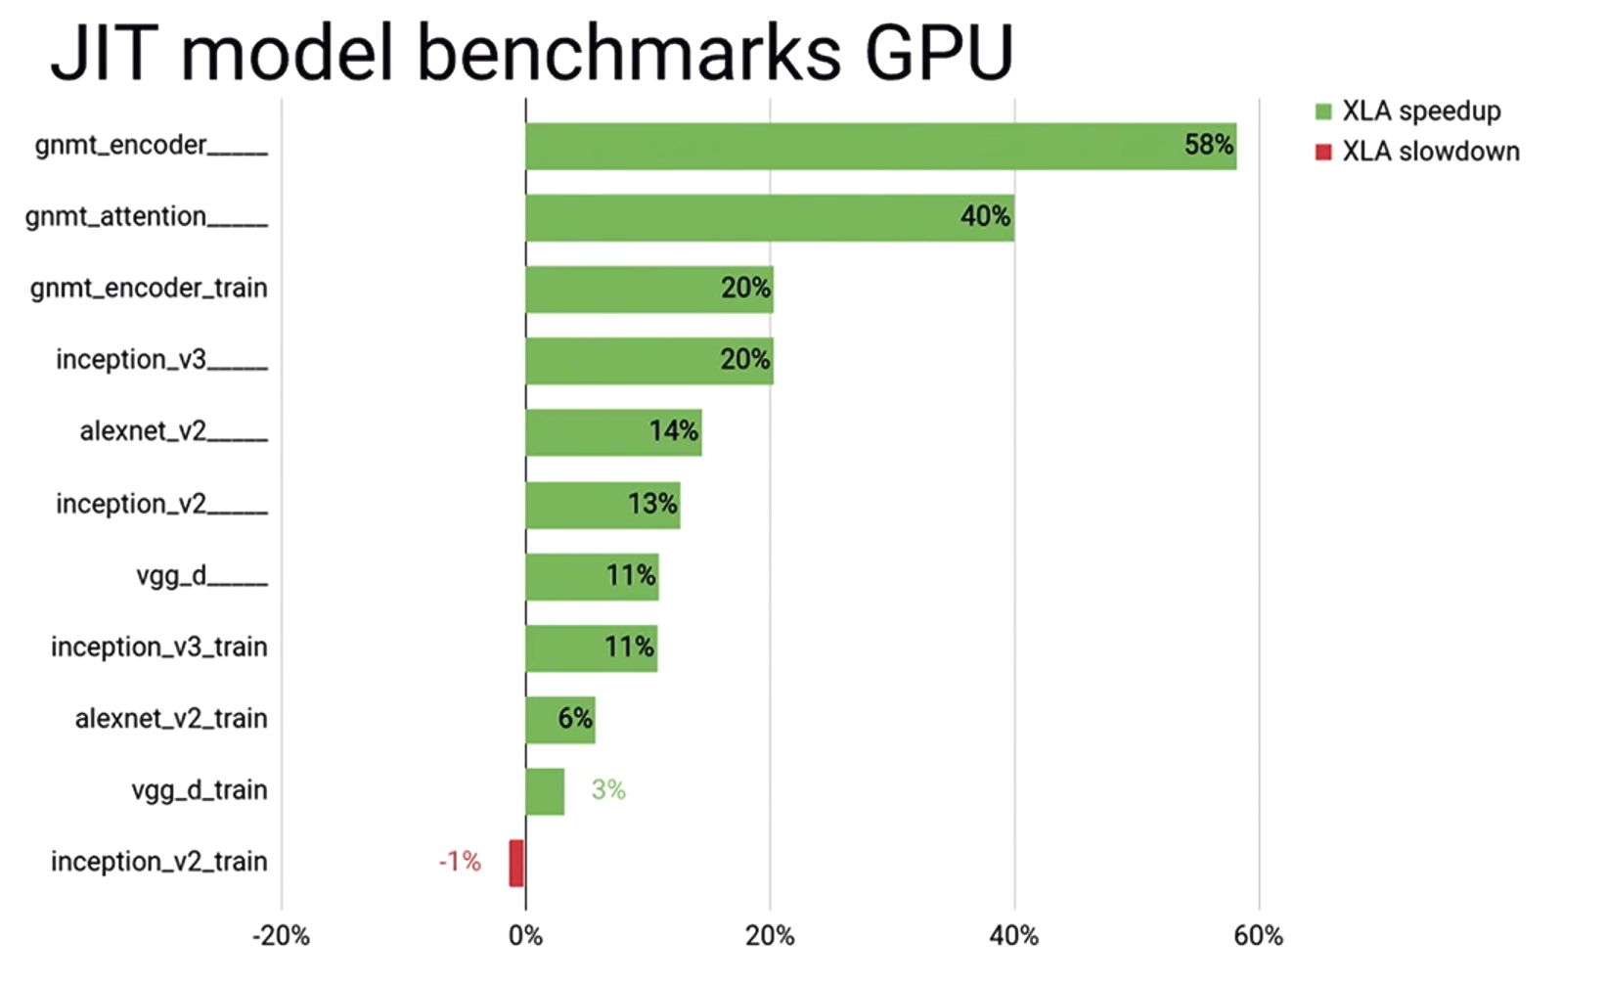
JIT Model Benchmarks GPU

Slide 33
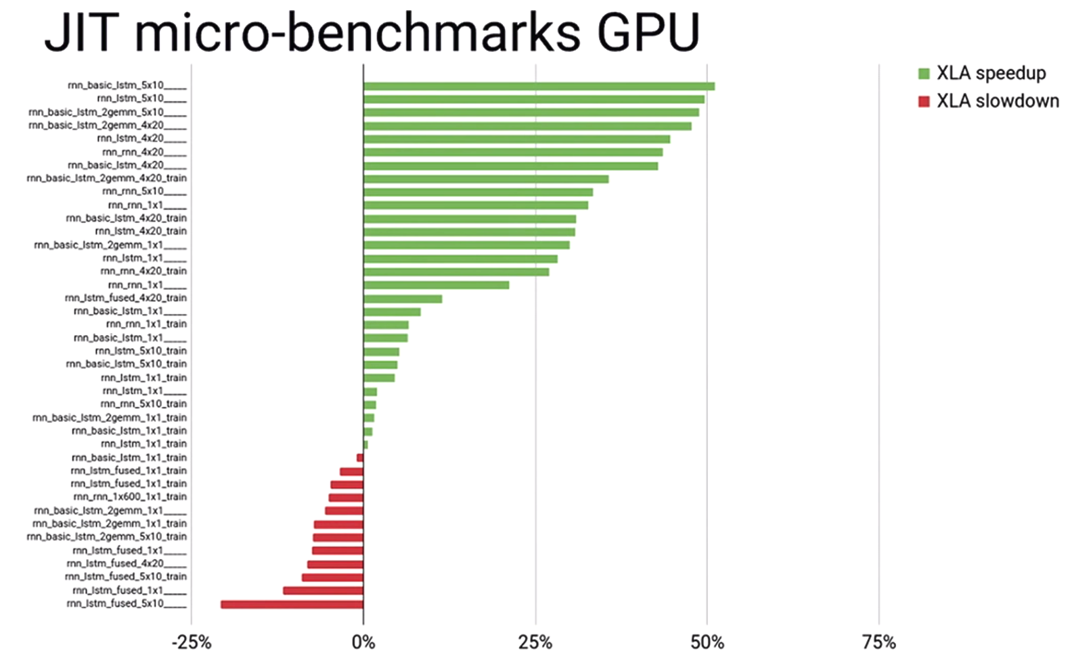
JIT Micro-Benchmarks GPU

Slide 34
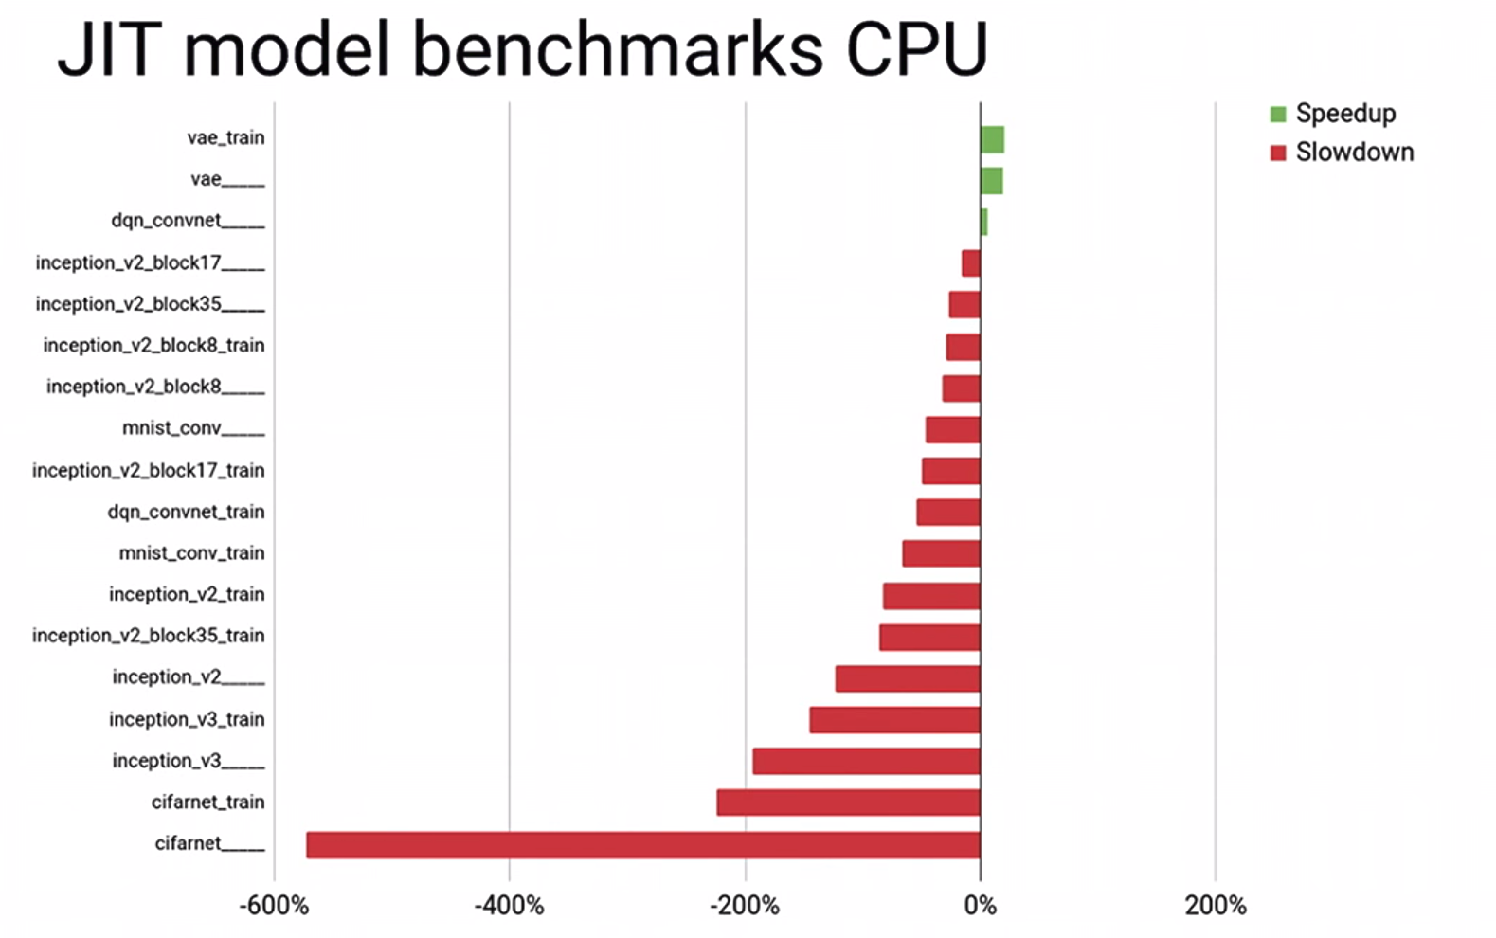
JIT Model Benchmarks CPU

Slide 35


XLA in Application
Server-side:
XLA’s JIT compilation and specializtion
Model-shaped benchmark wins up to 60%
SyntaxNet latency reductions: $200μs⇒5μs$
Mobile-side:
XLA’s Ahead-of-Time compilation
Eliminate much of TensorFlow runtime
LSTM model for mobile: $2.6MB⇒600KB$

Slide 36
Thank you for your kind attention!

Slide 37
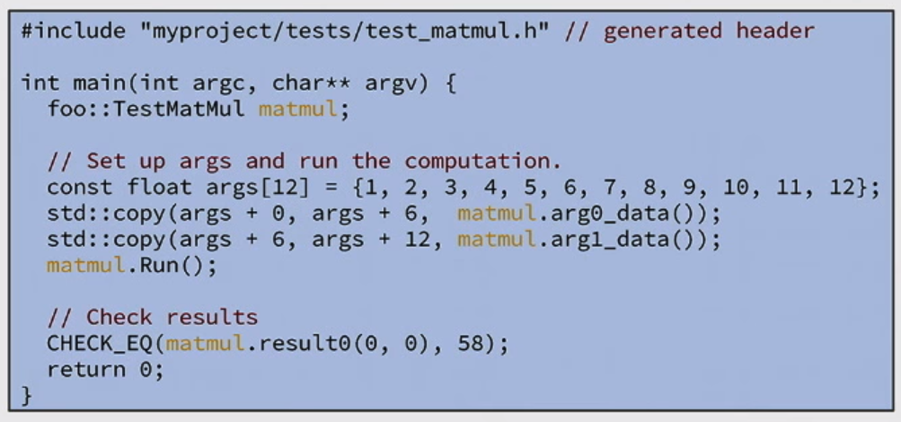
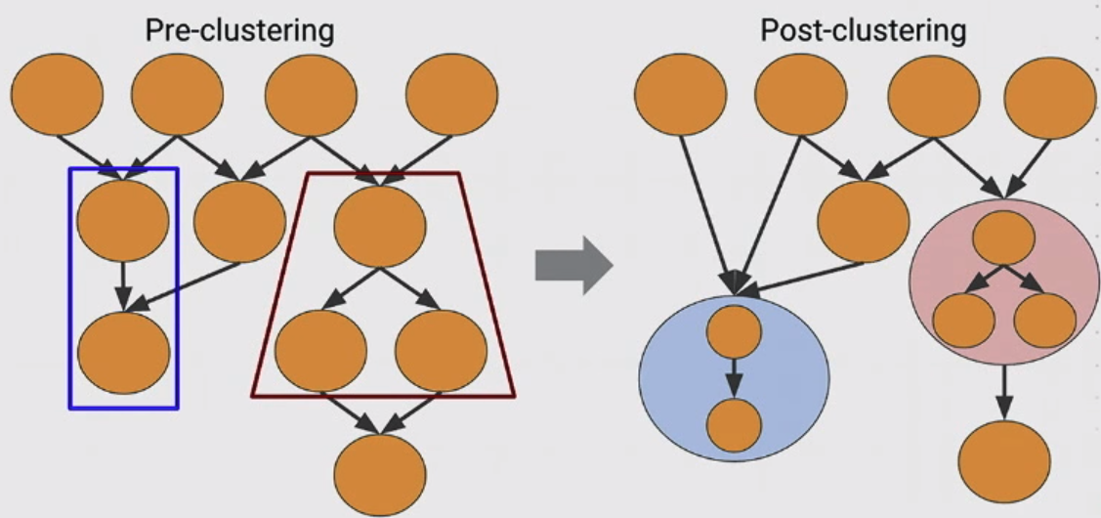

Slide 38
Flexibility
Input0
f32[???]
Input1
f32[???]
Op
Add
f32[???]
Tensor
...

Slide 39


